Slide 1
205 : Computer Organization and Architecture
Probidita Roychoudhury
Department of Computer Science
St. Anthony’s College

Slide 2
Organization Vs Architecture
Computer Organization : The way the hardware components are connected to form a computer system.
Computer architecture : Structure and behavior of the various functional units of the computer and their interactions.

Slide 3
What you already know (???)‏
Bits and Bytes
  How to represent information in the computer
Digital Circuits
  How to construct circuits to process information
Functional Units of the Computer
  CPU, ALU, Memory etc.

Slide 4
What you will learn in this course
Central Processing Unit
Arithmetic and Logic Unit
Memory Organization
Input/Output Organization
Parallel Processing
Multiprocessor

Slide 5
Text Books
Mano, M. M., Computer System Architecture (Third Edition), New Delhi: Prentice-Hall India, 2002
Hamacher, V. C.; Z. G. Vranesic; S. G. Zaky, Computer Organization (Fourth Edition), New Delhi: Tata McGraw-Hill, 1996

Slide 6
UNIT I
Central Processing Unit

Slide 7
“Brain” of the computer
The CPU performs bulk of the processing jobs.
Major components
  Register Set
    Stores temporary data during execution of instructions
  Arithmetic and Logic Unit
    Performs operations to execute instructions
  Control Unit
    Supervises the operation of the ALU and transfer of data between register set and ALU

Slide 8
Components of CPU
REGISTER SET
CONTROL UNIT
ARITHMETIC AND LOGIC UNIT

Slide 9
General Register Organization
Need to store values during processing.
Access to memory too time consuming .
Need for fast storage.
Registers communicate through the common bus system.

Slide 10
Example 8085 processor
General purpose registers
  Six 8-bit registers named B,C,D,E,H,L
Other special purpose registers
  Stack pointer
  Program counter
  Accumulator
  Flag register
  Increment/Decrement register
  Temporary register

Slide 11
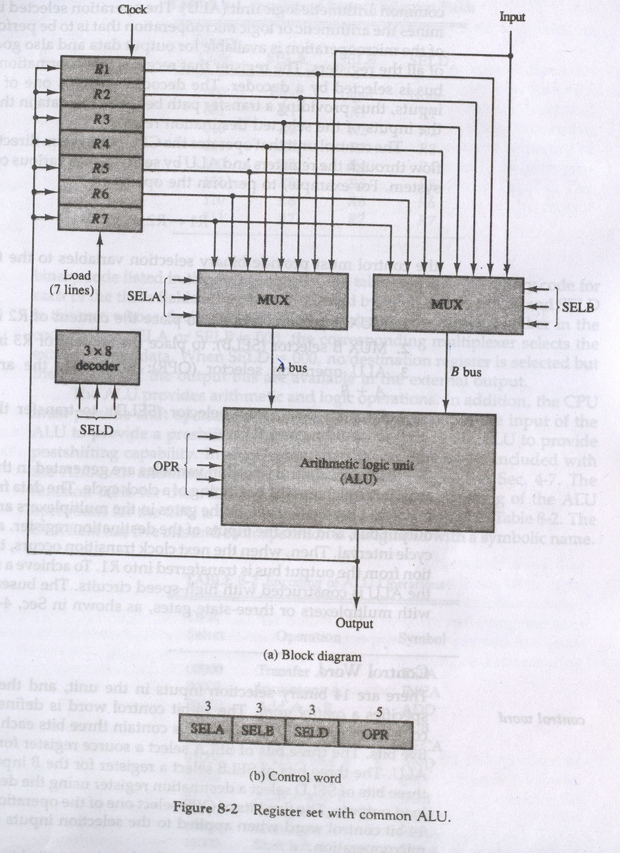

Slide 12
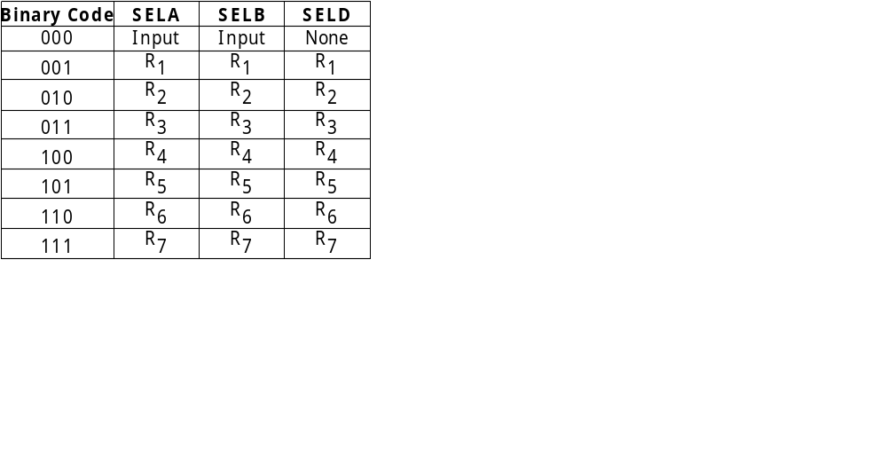
Encoding of Register selection fields.

Slide 13
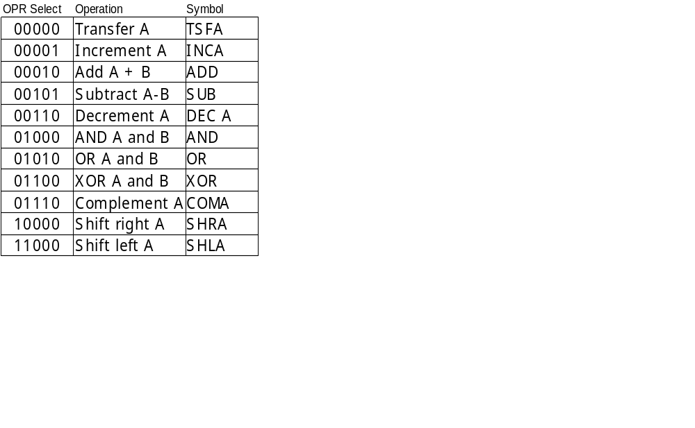
Encoding of ALU operation

Slide 14
Example
R₁ ← R₂ + R₃
MUX A selection (SELA): to place the content of R2 into bus A
MUX B selection (SELB): to place the content of R3 into bus B
ALU operation selection (OPR): to provide the arithmetic addition (A + B)‏
Decoder destination selection (SELD): to transfer the content of the output bus into R₁
The four control selection variables are generated in the control unit.

Slide 15
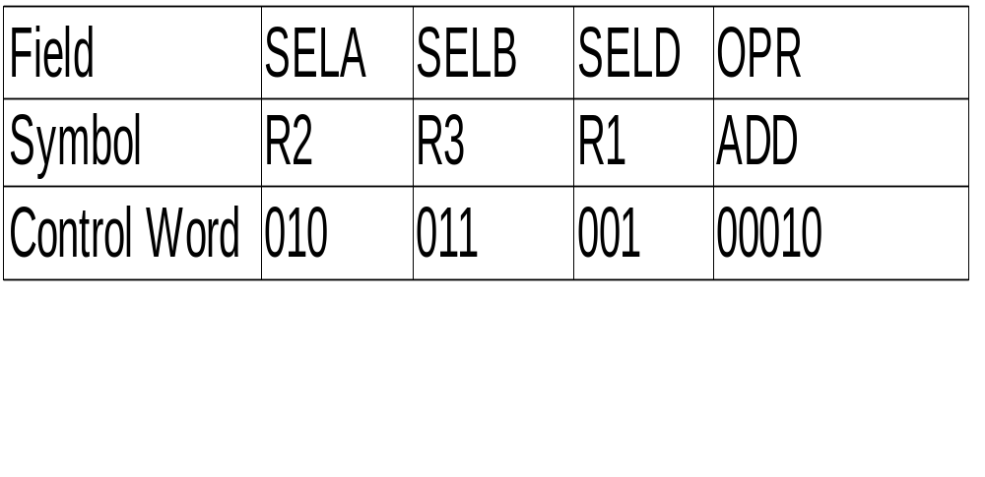
Example - contd.
The various selection variables form a 14 bit control word

Slide 16
Stack Organization
A useful feature included in the CPU.
Item stored first is the last to be retrieved.
Two operations- push (insert to stack ) and pop (delete from stack)
Register that holds the address of the stack – Stack Pointer (SP)
Can be implemented as Register Stack or Memory Stack

Slide 17
Register Stack
organized as a collection of a finite number of registers.
63
FULL
EMTY
2
SP
1
0
DR

Slide 18
Push operation
PUSH SP ← SP + 1 increment stack pointer
M [SP] ← DR write item on top of the stack
If (SP = 0) then (FULL ← 1)
check if stack is full
EMTY ← 0 mark the stack not empty.

Slide 19
Pop Operation
POP DR ←M[SP] read item from the top of stack
SP ←SP –1 decrement SP
If (SP = 0) then (EMTY ←1)
check if stack is empty
FULL ← 0 mark the stack not full.

Slide 20
Memory Stack
Implemented in a random-access memory attached to a CPU.
A portion of memory is assigned to a stack and a processor register is used as the stack pointer.

Slide 21
Computer memory with program, data and stack
PC
Program
1000
AR
2000
Data
Stack
3000
DR
SP
3999
4000
4001

Slide 22
Push and Pop Operations
Push : SP ←SP-1
  M[SP] ←DR
Pop : DR ←M[SP]
  SP ←SP +1

Slide 23
Reverse Polish Notation
Evaluation of arithmetic expressions in a stack organization.
Infix notation : Commonly arithmetic expressions written in infix notation- A * B
Prefix or Polish notation: Operator before operands- *A B
Postfix or Reverse Polish Notation : Operator after operands – A B *

Slide 24
Instruction Formats
The most common fields found in instruction format are:-
  An operation code field that specified the operation to be performed
  An address field that designates a memory address or a processor registers.
  A mode field that specifies the way the operand or the effective address is determined.

Slide 25
Instruction formats
The operation code field of an instruction format is a group of bits that define various processor operations.
The address field is either a memory address or a register address.
There may be varying number of address fields depending upon the internal organization of the CPU registers.

Slide 26
Types of CPU register org.
Single Accumulator Organization
  Single accumulator register
  Instruction formats use one address field
  ADD X ; AC ← AC + M[X]
General Register Organization
  More than one general purpose registers
  Instruction formats may use two or three address fields
  ADD R1,R2 ; R1 ←R1+R2
  ADD R1,R2,R3 ; R1 ←R2+R3

Slide 27
Types of CPU register org. contd.
Stack Organization
  PUSH and POP operations require one operand
  PUSH X ; TOS ←X
  Operation type instructions do not need any address field as the operation is performed on the item(s) at the top of the stack.
  ADD ; TOS ← (A + B)

Slide 28
Evaluate X = (A + B) * (C + D)
Three Address Instructions
ADD R1, A, B ; R1 ←M [A] + M [B]
ADD R2, C, D ; R2 ← M [C] + M [B]
MUL X, R1, R2 ; M [X] ← R1 * R2
Advantage: shorter programs
Disadvantage : too many bits required to represent three addresses

Slide 29
Evaluate X = (A + B) * (C + D)
Two Address Instructions
MOV R1, A ; R1 ← M [A]
ADD R1, B ; R1 ← R1 + M [B]
MOV R2, C ; R2 ← M [C]
ADD R2, D ; R2 ← R2 + M [D]
MUL R1, R2 ; R1 ← R1 * R2
MOV X1 R1 ; M [X] ← R1
Most commonly isef.

Slide 30
Evaluate X = (A + B) * (C + D)
One address instructions : accumulator organization
LOAD A ; AC ←M [A]
ADD B ; AC ← AC + M [B]
STORE T ; M [T] ← AC
LOAD C ; AC ← M [C]
ADD D ; AC ← AC + M[D]
MUL T ; AC ← AC + M[T]
STORE X ; M [×]← AC
All operations are done between the AC register and a memory operand. T is the address of a temporary memory location required for storing the intermediate result.

Slide 31
Evaluate X = (A + B) * (C + D)
Zero Address Instructions : stack organization
PUSH A ; TOS ← A
PUSH B ; TOS ← B
ADD ; TOS ← (A + B)
PUSH C ; TOS ← C
PUSH D ; TOS ← D
ADD ; TOS ← (C + D)
MUL ; TOS ← (C + D) * (A + B)
POP X ; M [X] TOS

Slide 32
Addressing Modes
The way the operands are chosen during execution of an instruction is determined by the addressing mode.
Opcode
Mode
Address
Instruction Format with mode field

Slide 33
Purpose of Addressing modes
To provide programming flexibility to the user like pointers to memory, counters for loop control, indexing of data, etc.
To reduce the no. of bits in the addressing field of the instruction.

Slide 34
Instruction Cycle
Fetch the instruction from memory
  Program counter (PC) holds the address of the next instruction to be executed.
  PC incremented each time an instruction is fetched.
Decode the instruction
  Determines operation to be performed, addressing mode and location of operands.
Execute the instruction

Slide 35
Addressing Modes
Mode fields is used to locate operands.
If instruction contains an address field, it may be a register or a memory address.
If more than one address field, each field is associated with its own mode.

Slide 36
Types of addressing modes (1)
Implied Mode- operands are specified implicitly in the instruction itself. Eg. “Increment Accumulator”
Immediate Mode- the address field contains the operand itself instead of the address of the operand.
Register Mode- the address field contains the address of a CPU register which contains the operand.
Register Indirect Mode- the address field contains the address of a register which holds the memory address of the operand. Advantage : fewer bits required to represent a register than a memory word.

Slide 37
Types of addressing modes (2)
Autoincrement or Autodecrement –
  similar to register indirect mode except that the value of the register is incremented or decremented after it has been used to access memory. Usually used to refer to a table of data.
Direct Address mode-
  the address field contains the memory address of the operand.
Indirect Address Mode-
  the address field contains the address of the memory location that contains the operand.

Slide 38
Types of addressing modes (3)
Relative Addressing Mode-
  the address of the program counter is added to the address field to get the address of the operand.
  Usually used in branch type instructions.
  Lesser no. of bits to represent the relative address than compared to the full memory address.

Slide 39
Types of addressing modes (4)
Indexed Addressing Mode-
  The content of an index register is added to the address part of the instruction in order to obtain the effective address.
  Useful in case of an array.
Base Register Addressing Mode-
  The content of a base register is added to the address part of the instruction in order to obtain the effective address.
  The difference with Indexed addressing mode is in its use.
  Used for relocation of programs in memory.

Slide 40
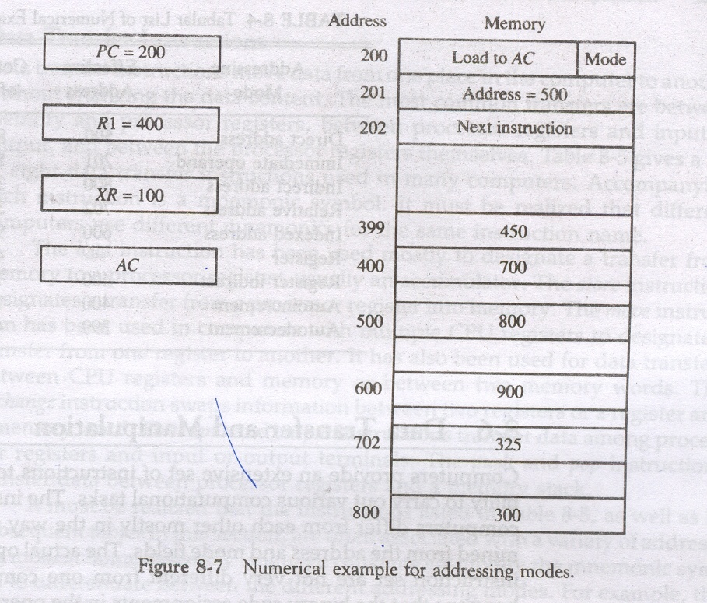
Numerical Example

Slide 41
Types of Computer Instructions
Three categories
  Data Transfer Instructions
    Transfer of data from one location to another without changing the contents
  Data Manipulation Instructions
    Operations like arithmetic, logical and shift
  Program Control Instructions
    Provides decision taking capabilities and changes the path taken by the program.

Slide 42
Some typical data transfer instructions
Name | Mnemonic | Description
Load | LD | Memory-register
Store | ST | Register-memory
Move | MOV | Register-register, register-memory, memory-memory
Exchange | XCH | Register-register, register-memory
Input | IN | Input-register
Output | OUT | Register-output
Push | PUSH | Register-stack
Pop | POP | Register-stack

Slide 43
Typical Program Control Instructions
Name | Mnemonic
Branch | BR
Jump | JMP
Skip | SKP
Call | CALL
Return | RET
Compare | CMP
Test | TST

Slide 44
Branch Instruction
Instructions are fetched sequentially.
Branch instruction change the value of the PC.
Can be conditional or unconditional.

Slide 45
Conditional Vs Unconditional Branch
If condition is met, the PC gets the value of the branch address.
The next instruction is fetched from this branch address.
If condition is not met, the next instruction is taken from the next location in the sequence.
Eg. “Branch if zero”.
The instruction causes a branch without any condition.

Slide 46
Skip Instruction
Causes the PC to be incremented twice- once in the fetch cycle and again in the execute cycle.
Zero address instruction.
Can be conditional or unconditional.

Slide 47
Subroutine Call and Return(1)
Self contained sequence of instructions.
Call instruction causes a branch to the first instruction of a subroutine.
  The address of the next instruction available in the PC is saved to a temp. location.
  Control is transferred to the beginning of the subroutine.
Return instruction causes a branch back to the calling program.
  Transfers the contents of the temp. location (return address) back to the PC.

Slide 48
Subroutine Call and Return(2)
Return address can be stored in-
  First memory location of subroutine
  Fixed location in memory
  Processor register
  Memory stack – most efficient
Recursive subroutine calls

Slide 49
Program Interrupt
Transfer of program control from a currently running program to another service program as a result of an external or internal generated request.

Slide 50
Subroutine Vs Interrupt
Subroutine
Initiated by execution of some instruction
Address of the subroutine determined from the address part of the instruction
Only the value of the PC stored before branching to the subroutine
Interrupt
Initiated by some external or internal signal
Address of the interrupt service routine determined by hardware
Interrupt procedure stores all information to describe the state of the CPU

Slide 51
Condition Code Registers
Sets of individual bits
  e.g. result of last operation was zero
Can be read (implicitly) by programs
  e.g. Jump if zero
Can not (usually) be set by programs
Notes:
29

Slide 52
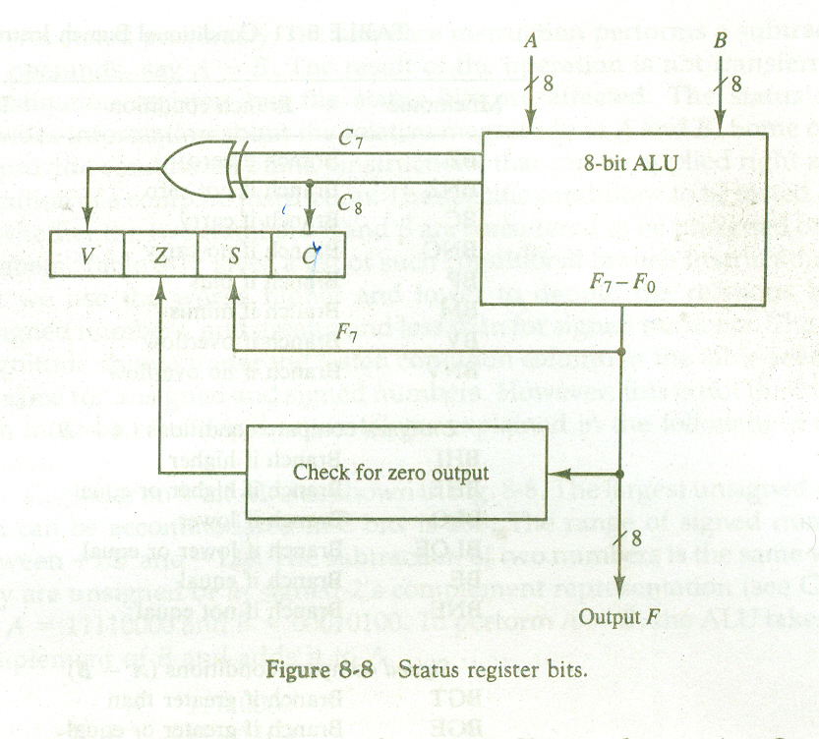
Status Register

Slide 53
Status Bit Conditions
Bit C is set to 1 if the end carry C8 is 1. It is cleared to 0 otherwise.
Bit S is set to 1 if the highest-order bit F7 is 1. Otherwise it is cleared to 0.
Bit Z is set to 1 if the output of the ALU contains all 0s.
Bit V is set to 1 if the XOR of the last two carries is 1, and cleared to 0 otherwise.

Slide 54
Conditional Branch Instruction
Mnemonic | Branch Condition | Tested condition
BZ | Branch if zero | Z=1
BNZ | Branch if not zero | Z=0
BC | Branch if carry | C=1
BNC | Branch if no carry | C=0
BO | Branch if positive | S=0
BM | Branch if minus | S=1
BV | Branch if overflow | V=1
BNV | Branch if no overflow | V=0

Slide 55
Unsigned Compare conditions (A-B)
BHI | Branch if higher | A>B
BHE | Branch if higher or equal | A>=B
BLO | Branch if lower | A<B
BLOE | Branch if lower or equal | A<=B
BE | Branch if equal | A=B
BNE | Branch if not equal | A<>B

Slide 56
Signed Compare conditions (A-B)
BGT | Branch if greater than | A>B
BGE | Branch if greater or equal | A>=B
BLT | Branch if less than | A<B
BLE | Branch if less or equal | A<=B
BE | Branch if equal | A=B
BNE | Branch if not equal | A<>B

Slide 57
Example
A=11110000 B=00010100
A =11110000
B’+1 =11101100
A – B =11011100
C=1 ,S=1 ,V=0, Z=0
Considering unsigned nos.
  A=240, B=20, A-B=220
  A>B and A<>B since C=1 and Z=0
Considering signed nos.
  A=-16, B=+20, A-B=-36
  A<B and A<>B since S=1 , V=0 and Z=0

Slide 58
Program Interrupt
Transfer of program control from a currently running program to another service program as a result of an external or internal generated request.

Slide 59
Subroutine Vs Interrupt
Subroutine
Initiated by execution of some instruction
Address of the subroutine determined from the address part of the instruction
Only the value of the PC stored before branching to the subroutine
Interrupt
Initiated by some external or internal signal
Address of the interrupt service routine determined by hardware
Interrupt procedure stores all information to describe the state of the CPU

Slide 60
State of CPU after execute cycle
Determined by
  Contents of program counter
  Contents of processor registers
  Contents of certain status conditions

Slide 61
Program Status Word (PSW)
A set of bits
Sign of last result
Zero
Carry
Equal
Overflow
Interrupt enable/disable
Supervisor
Notes:
31

Slide 62
Types of Interrupts
External Interrupts
  I/O devices (requesting transfer of data, I/O completion)
  Timing devices (elapsed time of an event)
Internal Interrupts (Traps)
  Use of illegal or wrong use of data or instructions
  Eg, overflow, divide by zero etc.
Software Interrupts
  Initiated by executing an instruction
  Eg. Switch from user mode to supervisor mode.

Slide 63
CISC and RISC
Complex Instruction Set Computer :
  A computer with large no. of instructions
  (100 or more).
Reduced Instruction Set Computer :
  Fewer instructions with simple constructs.

Slide 64
Driving force for CISC
Software costs far exceed hardware costs
Increasingly complex high level languages
Leads to:
  Large instruction sets
  More addressing modes
  Hardware implementations of HLL statements
Ease compiler writing
Improve execution efficiency
  Complex operations in microcode
Support more complex HLLs

Slide 65
Characteristics of CISC
A large no. of instructions (100 to 250)
Some instruction that perform specialized tasks and are used infrequently.
A large variety of addressing modes (5 to 20)
Variable length instruction format
Instructions that manipulate operands in memory.

Slide 66
Characteristics of RISC
Relatively few instructions
Relatively few addressing modes
Memory access limited to load & store instruction
All operations done within the registers of the CPU.
Fixed-length, easily decoded instruction format
Single-cycle instruction execution
Handwired rather than microprogrammed control.

Slide 67
Control Unit
A microoperation is an elementary operation performed with the data stored in registers.
  Register transfer microoperations
  Arithmetic microoperations
  Logic microoperations
  Shift microoperations
CU’s function is to initiate sequences of microoperations.

Slide 68
Register Transfer Microoperations
Information transferred from one register to another,denoted by R1←R2
If P=1 then R1←R2 represented as
P : R1←R2, P is called the control function which is a Boolean variable that is equal to 0 or 1.
Control Circuit
R1
Clock
P Load
n
R2

Slide 69
Bus and Memory transfer
Too many interconnections if separate lines used between each register.
A common bus system is more efficient.
Bus can be constructed using multiplexers and three-state buffers.

Slide 70
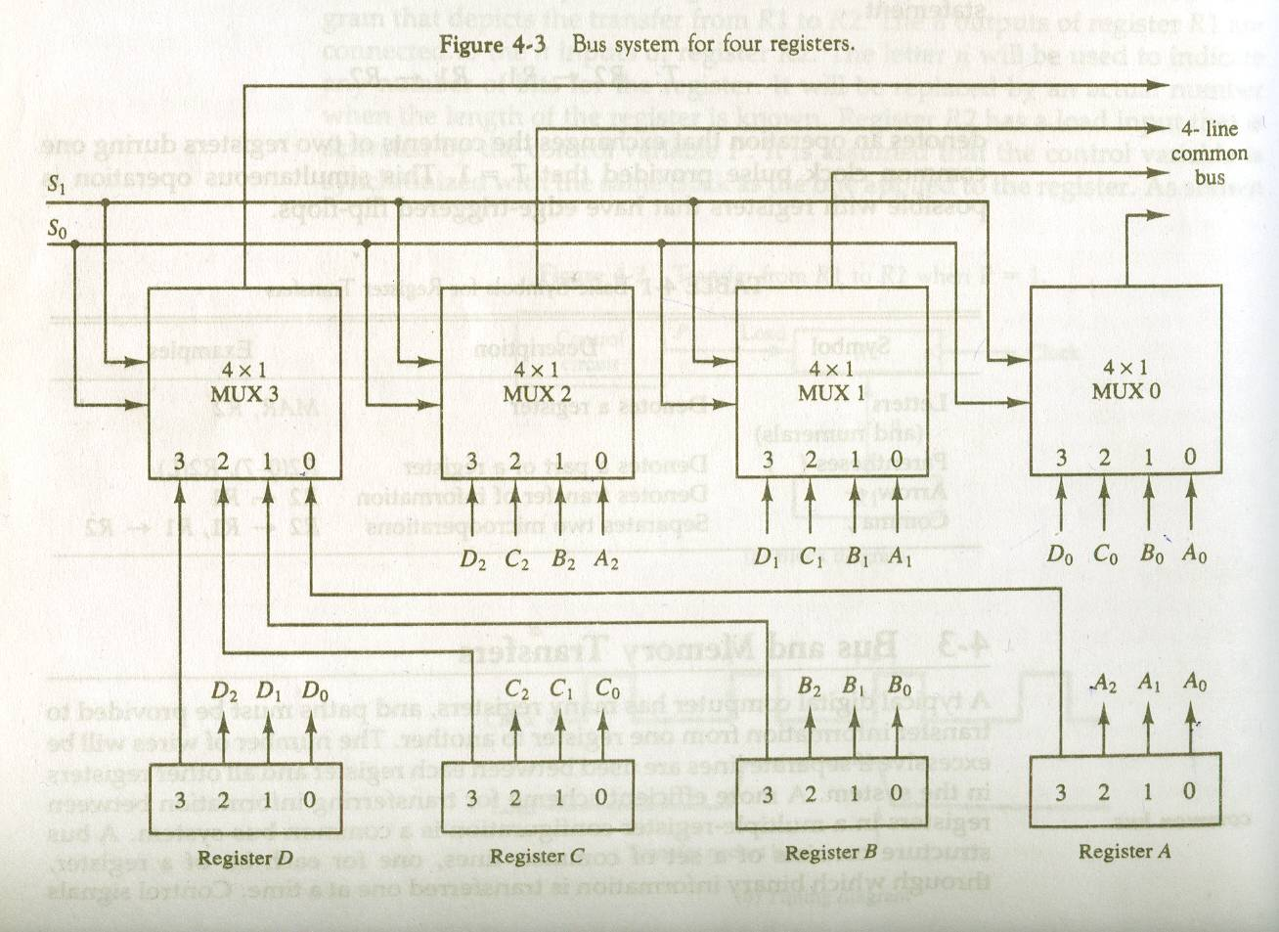
Bus system using multiplexers

Slide 71
Three State Bus Buffer
Constructed using three-state gates
Three states- 0,1,high impedance (output is disconnected, no logical significance)
Output Y=A if C=1
Normal Input A
High impedance if C=0
Control Input C
Three State Buffer gate

Slide 72
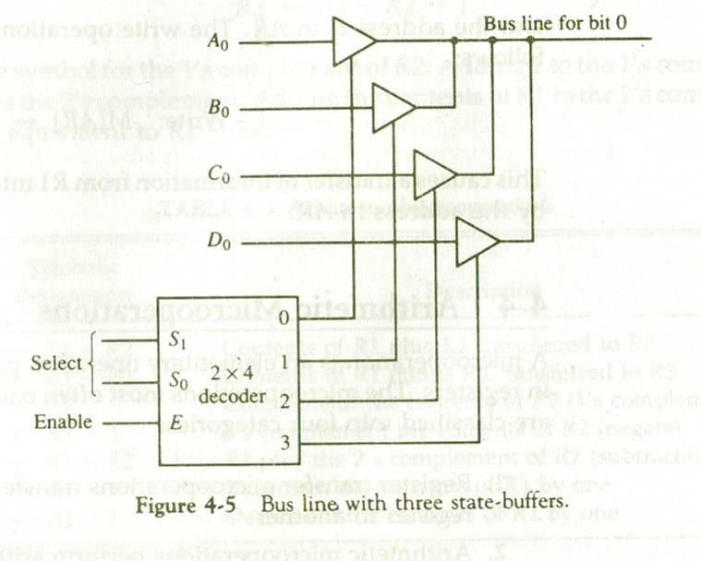
Bus Line with Three State Buffer

Slide 73
Memory Transfer
Two forms of transfer- read and write
Memory word symbolized by M
Read : DR ← M[AR],
DR is the Data Register and AR is Address Register which contains the memory address of the word to be read.
Write : M[AR] ← DR

Slide 74
Arithmetic Microoperations
Basic operations –Addition, Subtraction, Increment, Decrement and Shift.
Division and Multiplication are not included as multiplication is implemented as a sequence of addition and shift microops and division is implemented as a sequence of subtraction and shift microops.

Slide 75
Logic Microoperations (1)
Operations performed on strings of bits.
Basic operations – AND, OR, XOR, Complement
Applications –
  Selective set : sets to 1 the bits in register A where there are corresponding bits in register B. OR operation used.
  Selective complement-complement bits in A where there are corresponding 1s in B. XOR is used.

Slide 76
Logic Microoperations (2)
  Selective clear : clear to 0 the bits in A where there are corresponding 1s in B. A ∧ B’
  Mask : bits of A are cleared if there are corresponding 0s in B. AND is used.
  Insert : inserts a new value into a group of values. First mask unwanted bits and then OR with new bits.

Slide 77
Shift Microoperations
Used for serial transfer of data.
Used with arithmetic, logic operations.
Types of shift operations
  Logical shift : transfers 0 through the serial input. Two forms- shift left and shift right
  Circular shift : circulates the bits in the register without any loss of information. Two forms- circular shift left and circular shift right.
  Arithmetic shift: shifts a signed binary number to the left (multiply by 2) or right (divide by 2). Leaves the sign bit unchanged.

Slide 78
Hardwired and Microprogrammed
Control Unit initiates sequence of microoperations.
No. of microoperations available is finite.
Hardwired
  When control signals are generated by hardware using conventional logic design techniques.
  a combinational network generates a Boolean function set whose values are used to control a set of micro-ops: one Boolean value means ``don't do the operation'', the other value means ``do the operation''

Slide 79
Micro-programmed Control
Use sequences of microinstructions to control complex operations
A control unit whose binary control variable is stored in memory is called Microprogrammed Control Unit.

Slide 80
Implementation(1)
The control unit generates a set of control signals. Each control signal represented by 0 or 1.
The control signals at any given point of time is a string of 0’s and 1’s and is called a control word.
Have a sequence of control words for each machine code instruction
Each step is called microinstruction and complete set of steps required to process a machine instruction is called the microprogram.

Slide 81
Implementation(2)
The microprogram for each machine instruction is placed in ROM.
Dynamic microprogramming allows a microprogram to be loaded from auxiliary memeory.

Slide 82
Control Memory
Computers using MCU consists of two memories-
  Main memory – for storing user programs
  Control Memory – for holding microprograms
Each machine instruction initiates a series of microinstructions in control memory.
The microinstructions generates the microoperations to
  Fetch the instruction from main memory
  Evaluate the effective address
  Execute the operation
  Return control to the fetch phase to repeat the cycle for the next instruction

Slide 83
Microprogrammed Control Organization
Control Word
External Input
Next-Address
Generator
Control Address
Register
Control
Memory
Control
Data
Register
Next Address Information

Slide 84
Working of the Microprogrammed Control Unit
Control Memory Register holds the address of the microinstruction
Control Data Register holds the microinstruction read from control memory
The microinstruction contains a control word that specifies one or more micro operations for the processor

Slide 85
Next Address Generator
Some bits of the microinstruction contains information about the address of the next microinstruction.
While the microinstruction is being executed, the next address generator determines the address of the next microinstruction and transfers it to the CAR

Slide 86
Next Address Generator contd.
Next address can be specified by
  Incrementing the CAR by 1
  Transfer an external address
  Loading an initial address to start operations

Slide 87
Address Sequencing
To execute a single computer instruction, the control unit must –
  Load an initial address to the CAR (first microinstruction that initiates the instruction fetch)
  Increment the CAR throughout the fetch routine
  Initiate the microprogram routine that determines the effective address of the operand

Slide 88
Address Sequencing
  This routine can be reached through a branch which is determined by the mode field of the instruction
  Next, the micro routine that executes the instruction is fetched from memory.
    This is determined by the opcode of the instruction.
    Every opcode has a corresponding micro routine

Slide 89
Address Sequencing
Once the instruction has completed its execution, an unconditional branch takes back the control to the first address in control memory where the fetch microroutine is present.

Slide 90
Selection of address for control memory
Instruction Code
Mapping
Logic
Status bits
Branch Logic
MUX
select
Multiplexer
Subroutine register
CAR
Incrementer
Control Memory
Select a status bit
Branch Address
Microoperations

Slide 91
Address mapping
Transformation of the instruction code bits to an address in control memory
A special branch is used to branch to the first word in control memory where the micro routine for an instruction is located. This branch is based on the opcode bits of the instruction.

Slide 92
An example Address mapping scheme
1 0 1 1
Computer Instruction
Mapping bits 0 x x x x 0 0
Assumptions:
Op code : 4 bits
Control Memory Size : 128 words
0 1 0 1 1 0 0
Microinstruction address

Slide 93
Address Mapping Scheme
In this scheme, each microroutine can have four microinstrictions.
If no. of microinstructions is more than 4 then addresses 1000000 through 1111111 can be used.

